Slide 1
Wellbeing and Mindfulness for The Health Professions Educator
Carter Lebares, MD, FACS
Associate Professor of Surgery, UCSF
Director, UCSF Center for Mindfulness in Surgery
Sept 13th, 2022 Virginia Tech Carilion School of Medicine
Notes:
The role

Slide 2
Disclosures
Nothing to disclose

Slide 3
OUTLINE
• Individuals, the universal stress response, and resilience
• Physician wellbeing as an individual state and Workplace Wellness as a complex environment (systems and culture) that actively promotes wellbeing
• How individual wellbeing skills influence systems and culture
• Enhanced Stress Resilience Training (ESRT) and evidence of benefits
Notes:
Defining terms
Fundamental principles
How individual-level intervention like MF-based MS training

Slide 4
Objectives
Identify the 3 levels of change needed to promote health professions educator wellbeing
Recognize evidence supporting individual-level wellbeing interventions and the impact these have on systems- and organizational-level change
Identify techniques to support the mindfulness and well-being of health professions educators and learners

Slide 5


Slide 6
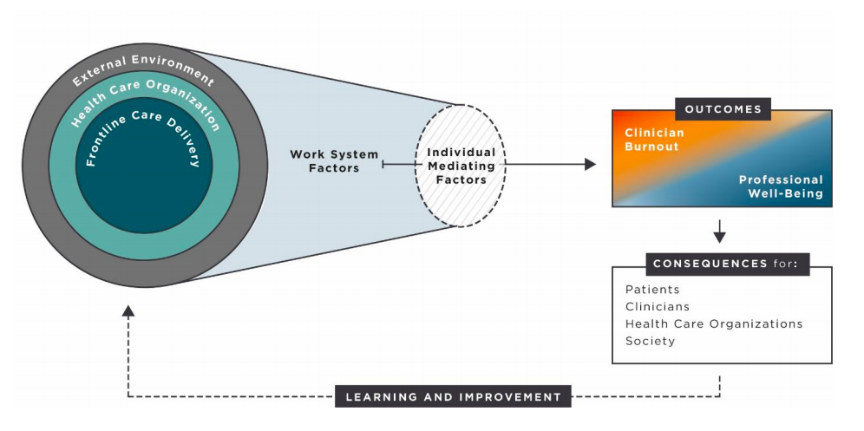
Conceptual Model of Physician Professional Wellbeing vs Burnout
National Academy of Medicine, Action Collaborative on Clinician Wellbeing and Resilience, 2017
Carayon, JAMA, 2019

Slide 7
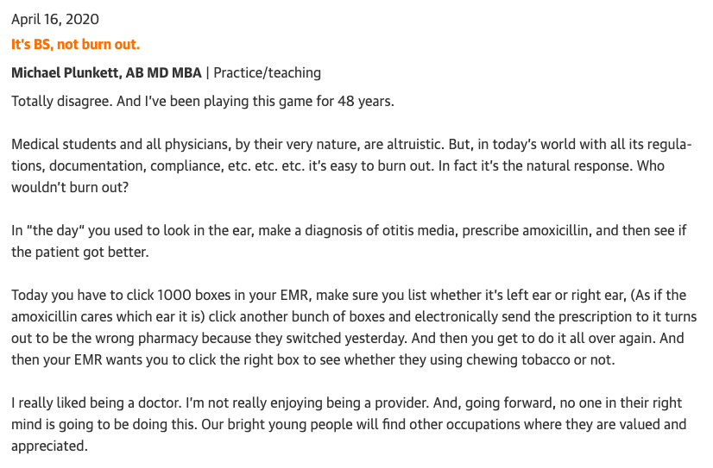
Notes:
An excerpt in response to a perspective piece in JAMA Surg about increased acts of altruism as the cure for our feelings of being burnt out.

Slide 8
Feeling Good vs Being Well
Feeling good IS personal and often situational
  Things that make us FEEL good aren’t always readily available or applicable to diverse situations
Wellbeing has established criteria, is constitutional, persistent and flexible
“More than physical health and housing. Well-being refers to the quality of a person’s relationships, their positive emotions, sense of resilience, realization of their potential, and overall satisfaction with life."
US Centers for Disease Control
Notes:
Back to the idea of whether WB lies in the personal or public domain, it is worth revisiting the specifics about how WB is defined.
The CDC definition speaks to WB as phenomena that integrates individuals, the systems around them and the culture they live in.
This is similar to the philosophical concept of Eudamonia, attributed to Aristotle. Eudamonia represents….
Modern research into human development and psychology reiterates that fulfillment and sense of purpose are closely dependent on one’s affect, connectedness, resources and opportunities. Making these elements of WB are FUNDAMENTAL.
This is in contrast to ‘Feeling Good’

Slide 9
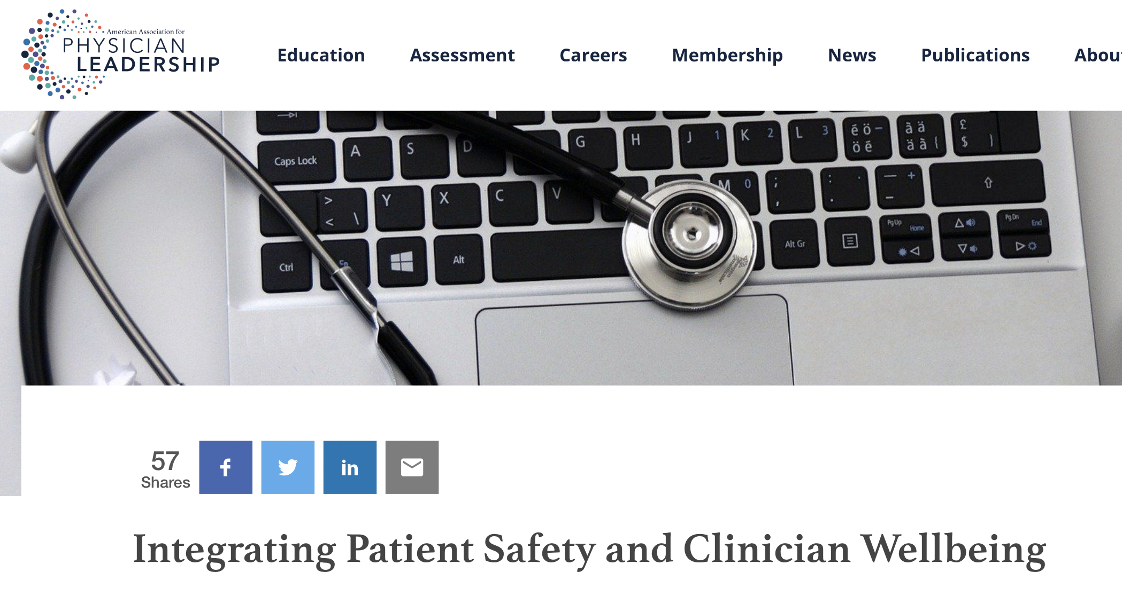
Defining and Defending Physician Wellbeing
“More than physical health and housing. Well-being refers to the quality of a person’s relationships, their positive emotions, sense of resilience, realization of their potential,
and overall satisfaction with life."
Privitera, American Association of Physician Leadership
Shanafelt, JAMA Int Med, 2017
Notes:
So the promotion of thriving/resilience has been termed “WELLBEING”, which is how I use this term here.
In this context WELLBEING refers to a set of targetable conditions that promote physician satisfaction, connectedness, and purpose. These conditions include optimized individual RESOURCES, humane and responsive SYSTEMS, and an environment of equitable OPPORTUNITY.
Internationally, we have begun to reframe our goals for physician wellbeing to PROMOTE resilience and thriving, not just to avoid burnout.
Wellbeing as such increasingly recognized as a key metric of safety and economic sustainability in healthcare.

Slide 10
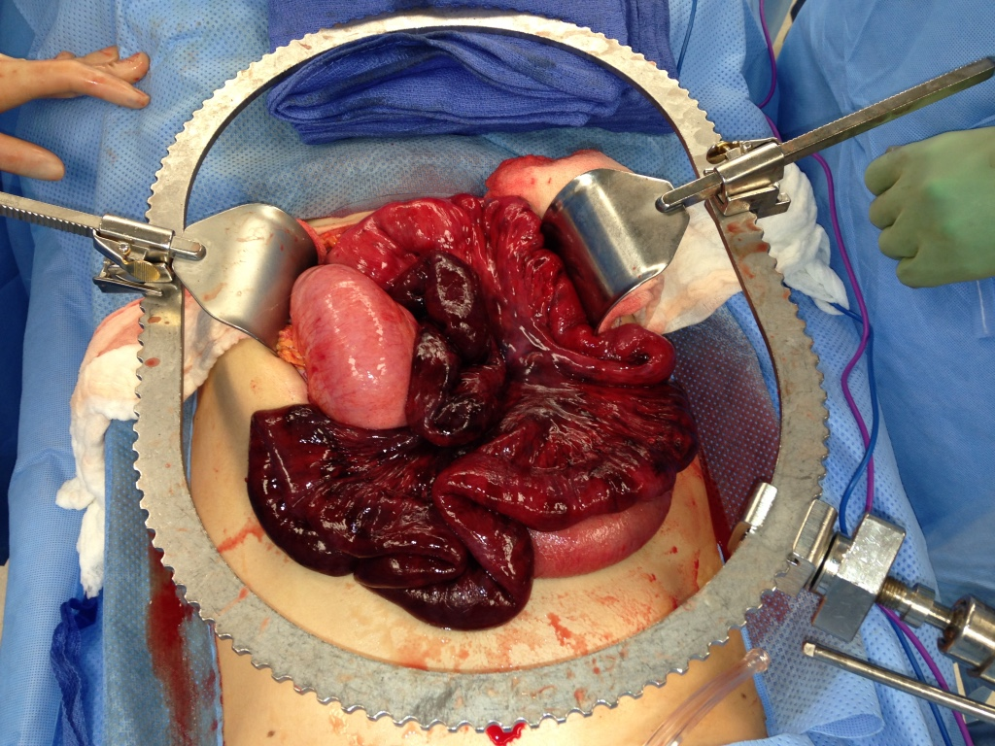
Individual Stress Differs

Slide 11

The Effort
Manage the Intrinsic Load
Cognitive Load Theory
Mental Chatter
Bias
Negative thinking
Self-doubt
Distraction
Capitalize on the Germane Load
Reduce the Extraneous Load
The Point
The Noise
Young, Med Teach, 2014

Slide 12
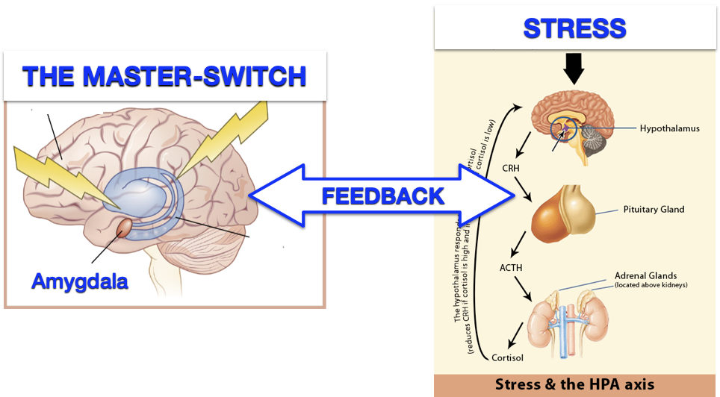
Targeting a Central Mechanism
PFC
McEwen, Neuropsychopharma, 2015
Lebares, JAMA NetW Open, 2019
Notes:
The wide applicability of MFT speaks to the very central, and therefore universal, mechanism that MFT targets – which is the way in which WE PERCIEVE STRESS.
ALTHOUGH stress often feels LIKE A FORCE OF NATURE (THOROUGHLY outside our control) this is in fact not the case. CONSIDER: that all stressors (walking home alone on a dark streer late at night, taking the ABSITE, or encountering unexpected bleeding in the OR) they all FEEL the same (rapid breathing, heightened visual acuity, maybe shaky hands),
But while shadows moving on a dark street might compel us to run, we are able to master this reaction elsewhere (like in the OR) and get down to business. IN FACT, IT IS OUR MINDS that prevent us from reacting to all stressors the same way. This is the result of feedback b/tn the Body and Mind, a process which WE CAN INTERVENE UPON.
And through ways we don’t fully understand, MF Training enhances our ability to do this.

Slide 13
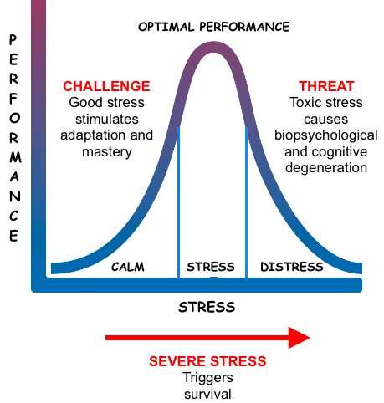
Not all stress is the same
CHALLENGE
Good stress
THREAT
Toxic stress
High Resources
High Demands
Yerkes-Dodson, 1908
Notes:
In surgery, ALTHOUGH stress Is commonplace - not all stressors are the same. We have all experienced how a difficult case can leave us feeling challenged and exhilarated, while a complication can leave us feeling drained and demoralized. Numerous studies have demonstrated that the balance between our resources and our demands determines how we weather stress. When our internal and external resources are low, stressors can become daunting and even toxic, but when they’re high we are more likely to see stressors as surmountable challenges.
Importantly, this reminds us that stress is on a continuum, meaning there are multiple points along this curve where we can intervene.

Slide 14

You can’t control the ocean, but you can learn to ride the waves…..
“Calm seas never made a good sailor.” ~ Franklin Delano Roosevelt

Slide 15

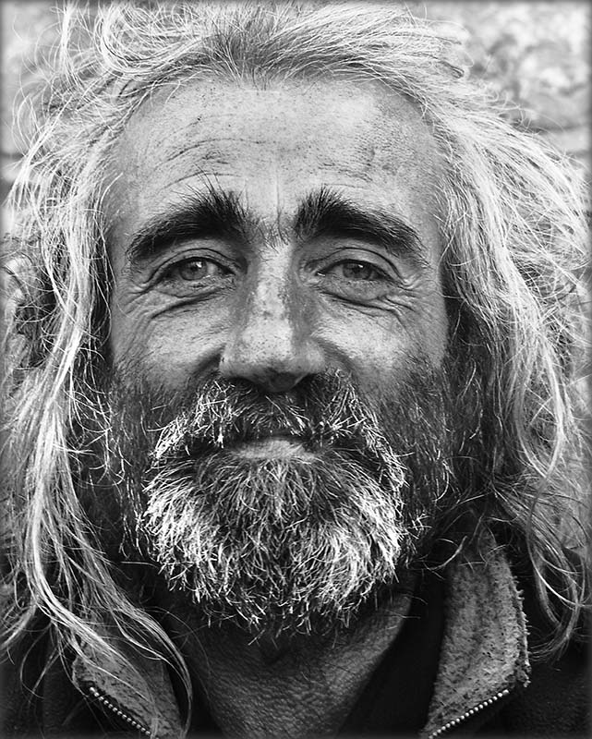
Adapting to Stress – Thriving Despite Adversity
Masten, Am Psychol, 2001
Notes:
Something we hear much less about, is the other end of the spectrum which is thriving: a state of joy, connectedness and purpose.
Thriving is not the absence of stress, but rather a state of experiencing stress as a challenge in stead of a debilitating threat. This is in fact the embodiment of RESILIENCE which by definition is the ability to thrive despite adversity.
This is a state available to all of us from time to time, exemplified when we ‘pull through’ or ‘rise to the occasion’

Slide 16

Theoretical Framework
The Upward Spiral of Positive Emotions
Support
Demand
Work
Satisfaction
Control
Job Demand Resource Theory
Broaden-and-Build Theory
Bakker, Occup Health Psychol, 2017
Fredrickson, PNAS, 2001
Notes:
That said there are some standard good places to start.
First - EXPLORATION
Start with the literature, know the evidence base, and ground yourself in theory
Will help you if you’re met with resistance or distaste.
(will return to the importance of the evidence base later)

Slide 17

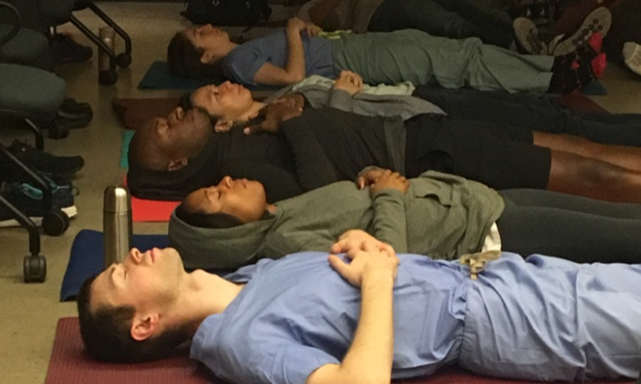
Mindful Surgeon
Enhanced Stress Resilience Training (ESRT)
Attention
Meta-Cognition
(Ability to sustain focus, but also to direct awareness)
(Ability to see beyond personal perspective and reframe)
Emotional Regulation
(Ability to notice emotions, but also to respond without reactivity)
Notes:
So, with these things in mind, we formalized a mindful mental training curriculum for surgeons called Enhanced Stress Resilience Training or ESRT.
ESRT is comprised of five 1-hour classes with 90% of each class spent IN EXPERIENTIAL TRAINING. Practicing with the mind to strengthen
ATTENTION
EMOTIONAL REGULATION
META-COGNITION

Slide 18
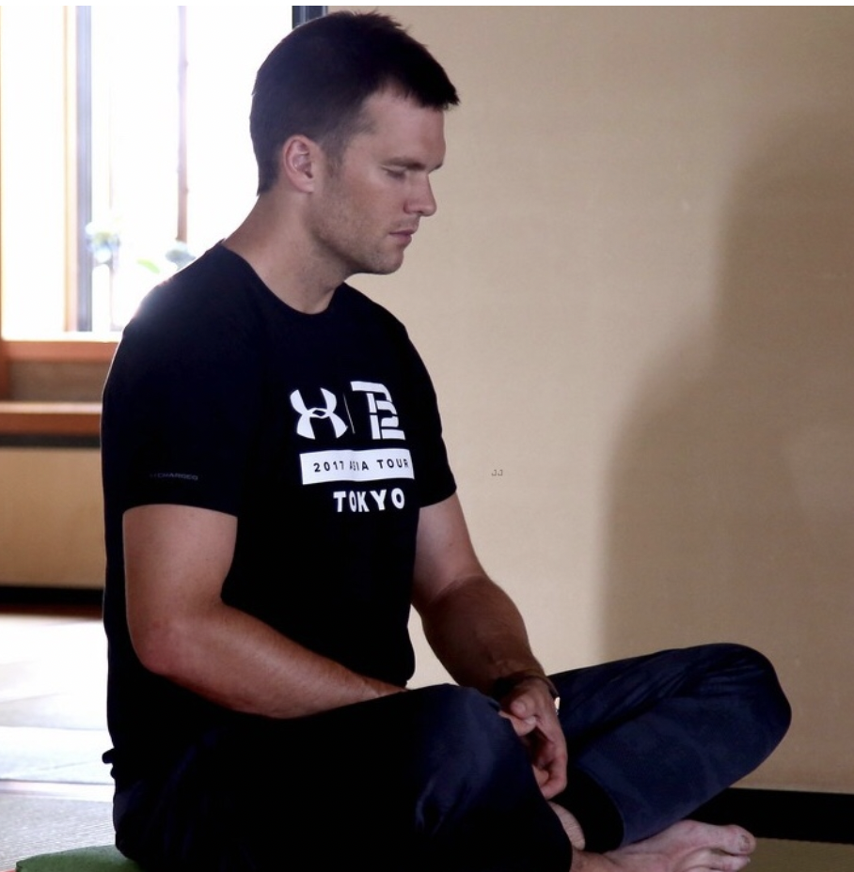
“The undisciplined mind creates useless chatter, castes
automatic judgments, projects our emotions onto our experiences, and anticipates outcomes before they’ve happened.”
- Tom Brady

Slide 19

“It’s crazy to me that meditation is viewed as hokey.
Just look at the people who’ve done phenomenal things. Do they meditate? Absolutely.”
-Kobe Bryant

Slide 20
“Between stimulus and response there is a space. In that space is our power to choose... In our response lies our growth and our freedom.”
- Viktor Frankl (1905-1997)
Seamless Resolution
Life
Event
Response
Outcome
Torture
Variable Time Period
Marin & Lodato, ACS-QS Conference, 2020
Notes:
So What is MFT and what does it do?
This diagram describes a commonplace scenario: We’re going on about our lives and some event happens, good or bad, and invariably, we respond. Being that we’re human and time-compressed - our responses are often reflexive, or influenced by stress. Occasionally – like when we’re rested and happy – our responses are thoughtful and considered, in general leading to better outcomes.
And, while this scenario may seem unremarkable, it is actual critical. In fact, how we respond to life’s events is directly related to the quality of the lives we live.
As Victor Frankl (famed psychiatrist, philosopher and survivor of Auschwitz puts it: Between stim and response there is a space. In that space is our power to choose... In our response lies our growth and our freedom
And this is where mindfulness training intervenes. MFT teaches us to recognize this intervening space and take advantage of it. We become able to respond to life’s events, and not just react, even when we’re tired, stressed, or angry.

Slide 21
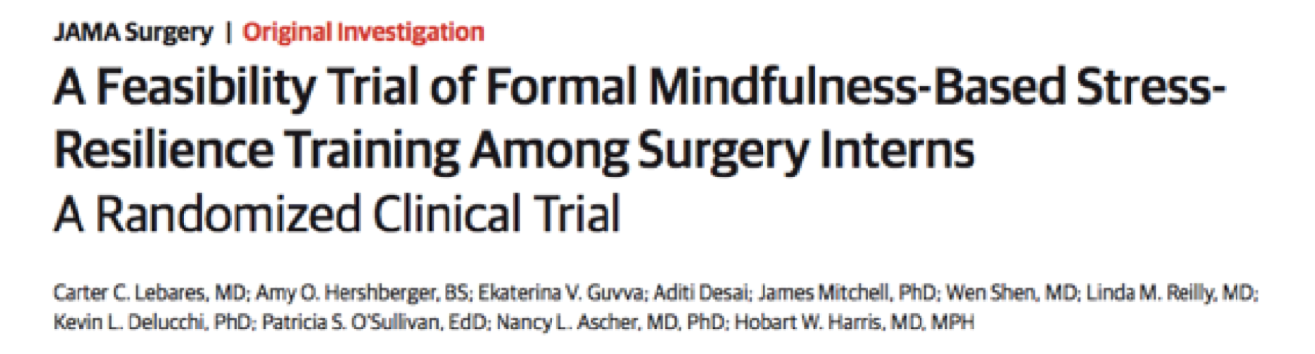

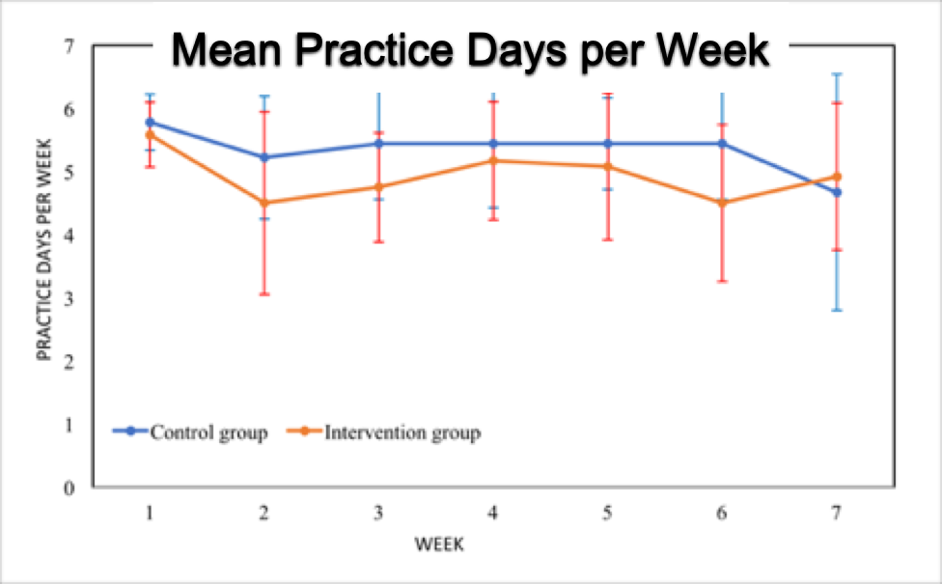
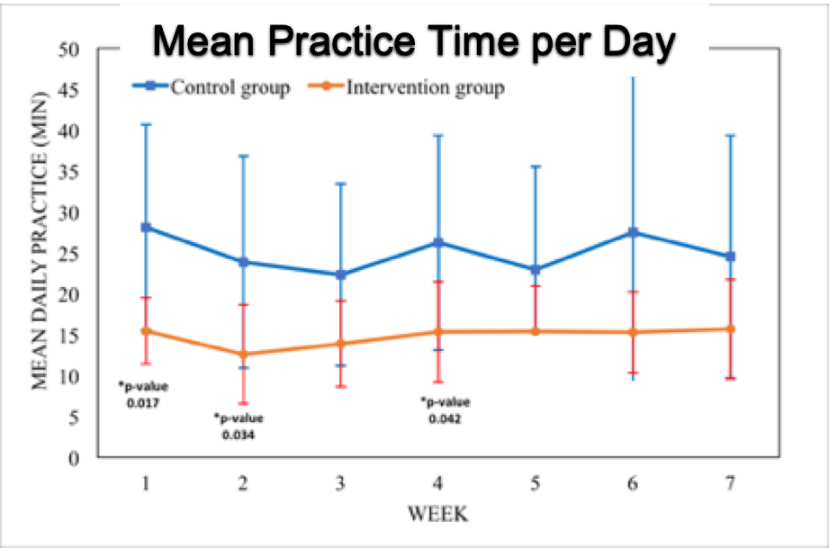
Feasibility
Han, Ann Int Med, 2019
Notes:
Over the last 5 years we’ve conducted two RCTs with longitudinal follow-up and several pre/post cohort studies. It bears noting that controls have all had the same protected time, close faculty interaction and peer-group community building as the ESRT intervention.
And still we’ve been able to demonstrate several promising things:
FIRST, that such an intervention IN SURGERY IS FEASIBLE.
ESRT prts were able to practice a mean of 5 days per week and a mean of 15min per day, for duration of the course.
And to a lesser extent over time

Slide 22
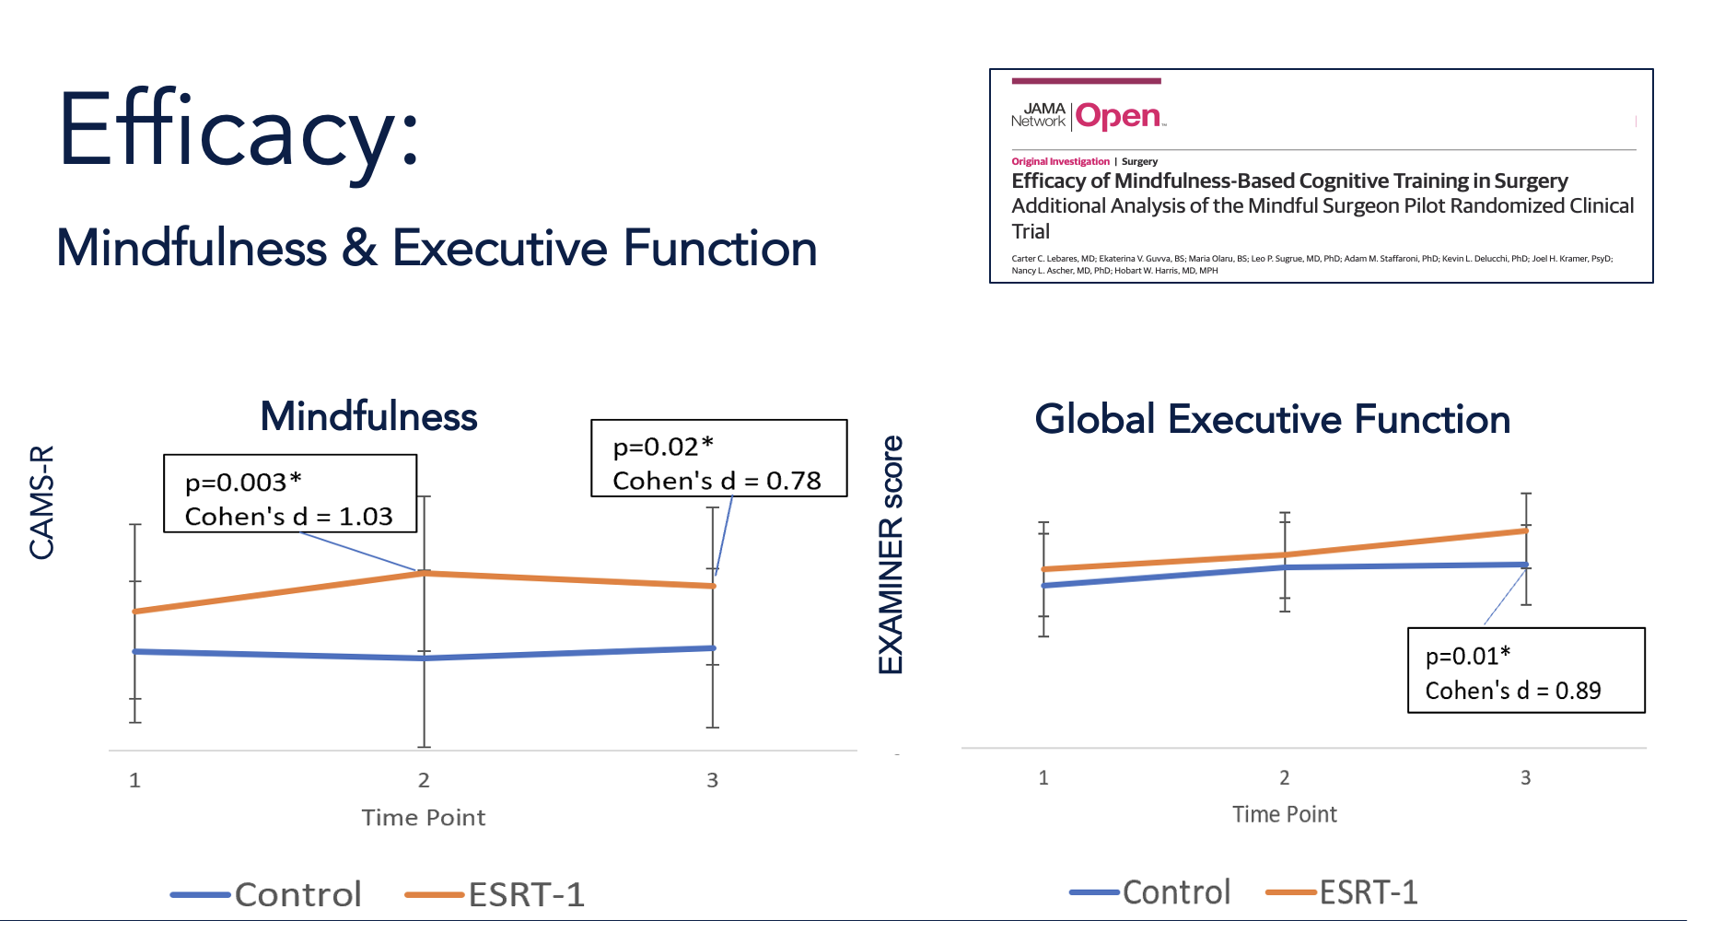

Slide 23
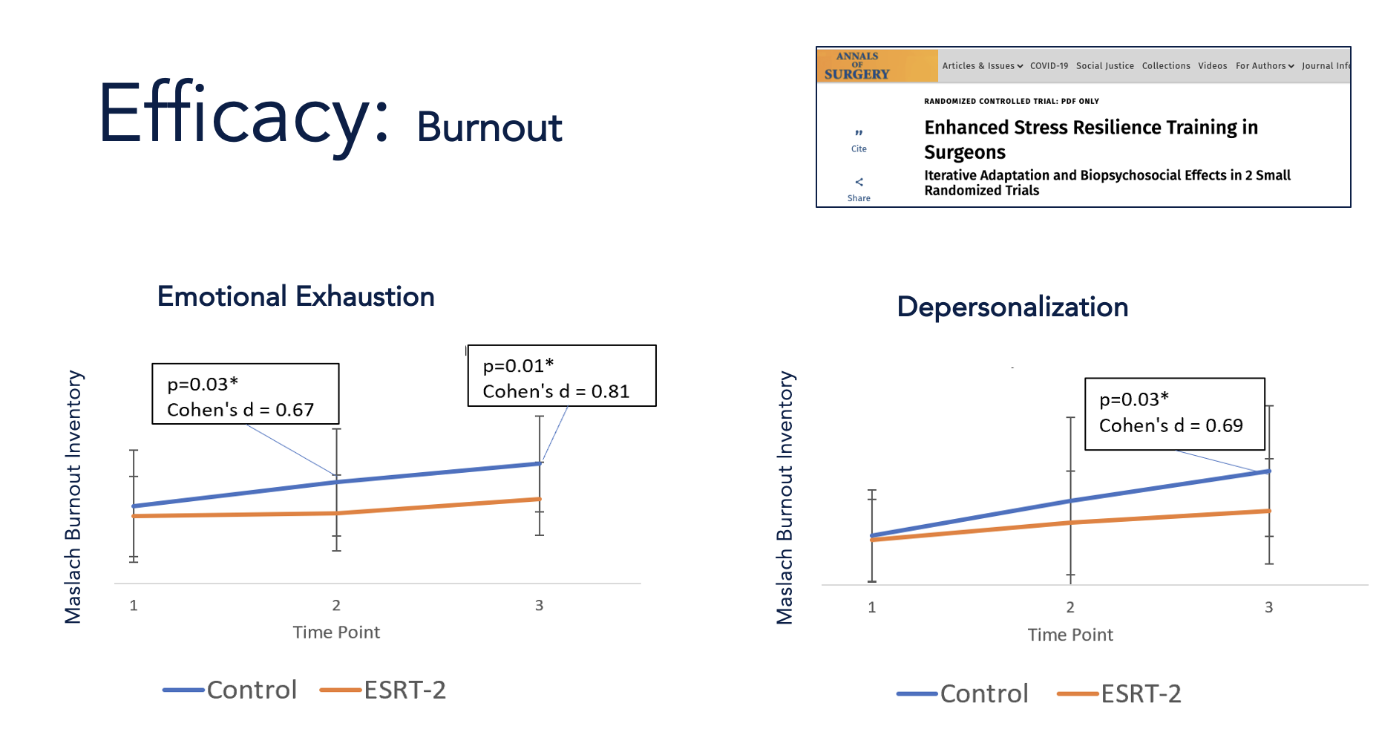

Slide 24
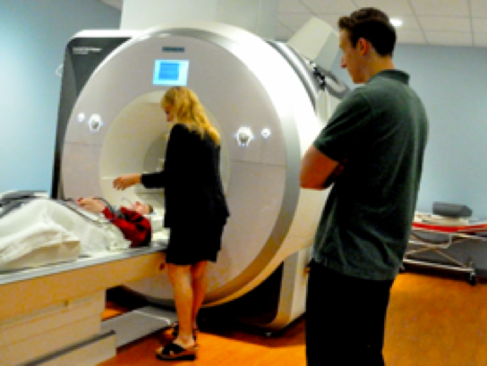
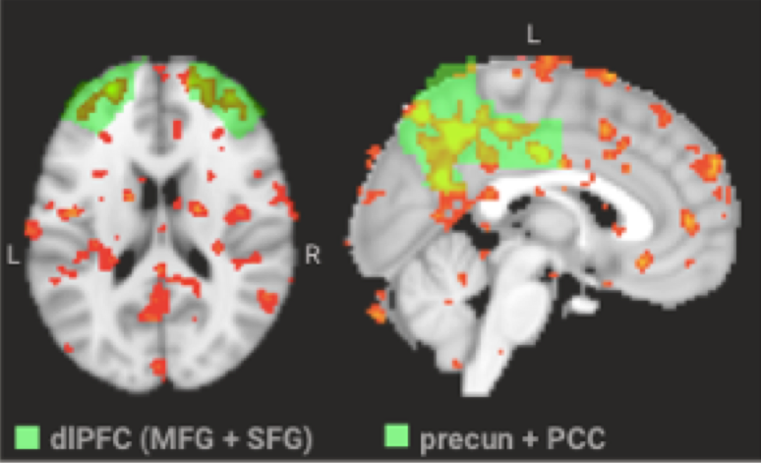
Neural Substrates of Mindfulness
dl-PFC
PCC/Precuneus
Lebares, JAMA NetW Open, 2020
Kral/Davidson, Soc Cog Aff Neurosci, 2019
Notes:
AND similar to the previously mentioned resilience studies in veterans, we have found there is a neural signature to training mindfulness mental skills to surgeons.
Specifically, in randomized trials of ESRT in surgeons vs active controls, we’ve seen significant increase in activation of the dl-PFC (or ‘EXECUTIVE CONTROL HUB’ of the brain – mentioned previously) and its connections to the posterior cingulate cortex and precuneus (which have been implicated in self-awareness and creativity).

Slide 25
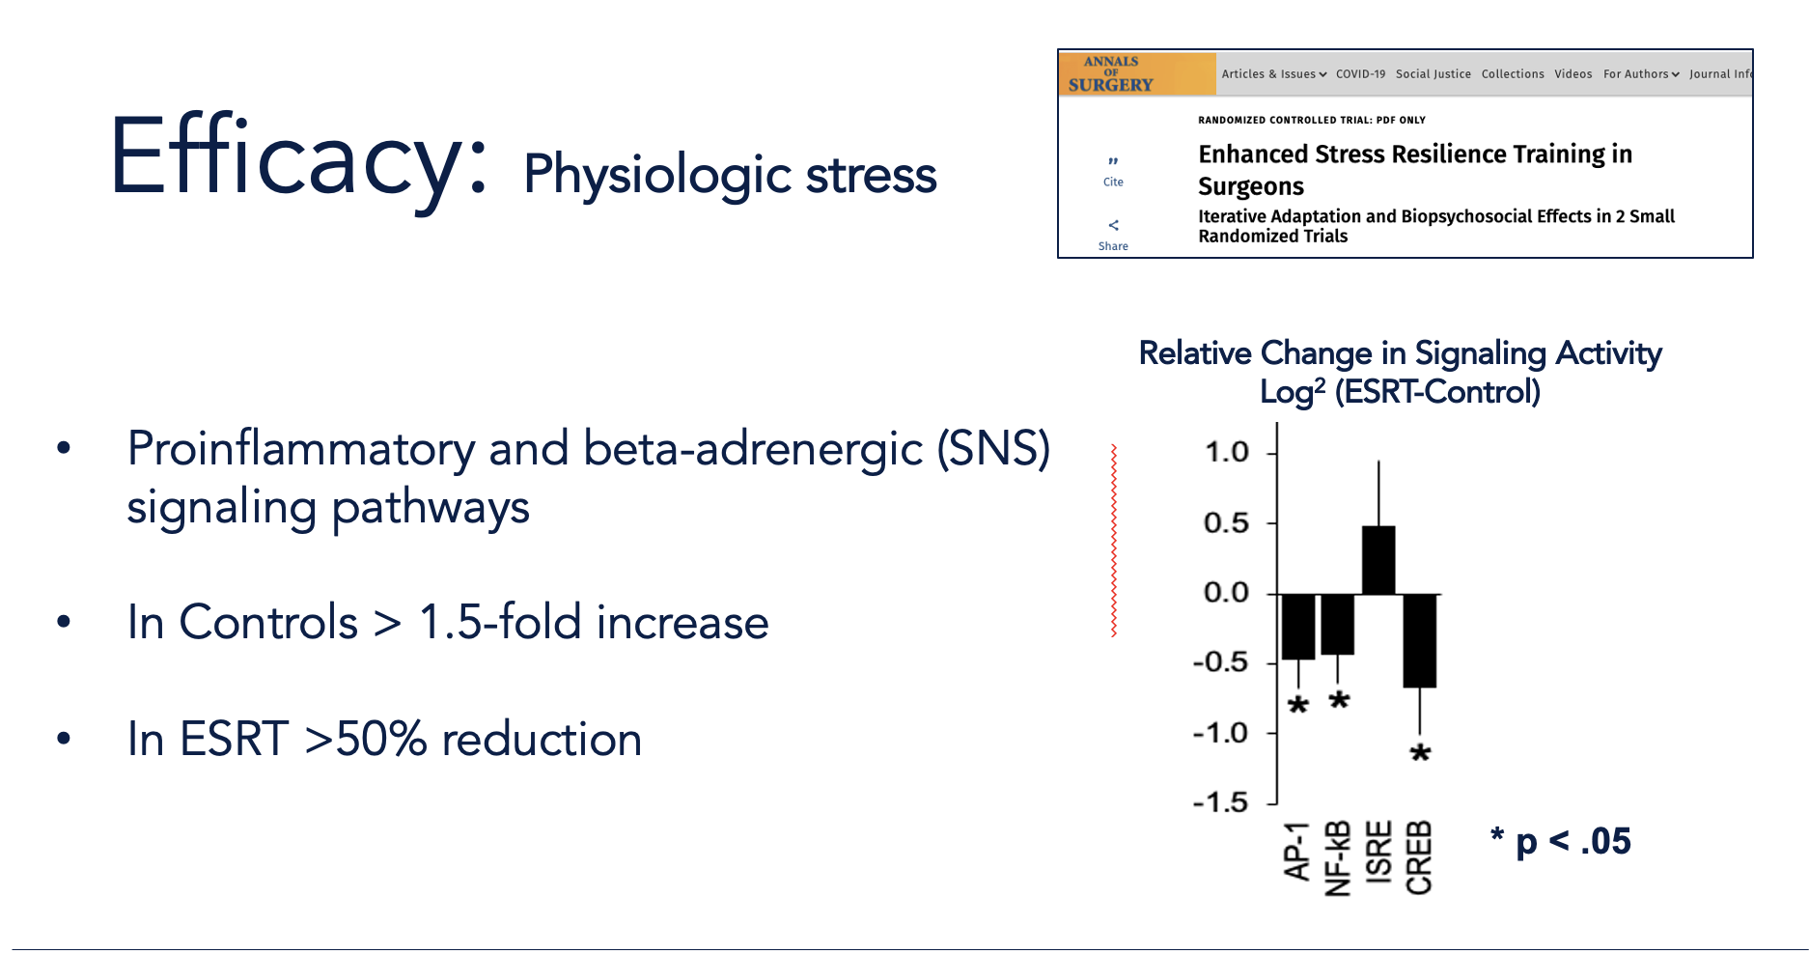
XXXXXXXXXXXXXX

Slide 26
“I can't believe how rich life is. It's amazing I didn't see this before; like I was living in the fog. I use these techniques…when I'm walking the halls in the hospital…teaching the med students…with patients. “
“I didn’t know I could be present. I always thought meditation couldn’t work for me, that I couldn’t do it, but now I see that I can. I do. I recently did a laceration repair. I wasn’t expecting it. I was surprised and nervous. My hands were shaking so badly! But then I focused on my breath, …I FELT it. I felt the focus and all I heard was my senior instructing me. My hands were still. I did it better than ever.
“At work, I am much less reactionary to pages, nurse requests…I have somehow gained some ‘space’ between certain stimuli and my reaction to them. I take a moment to understand my role and how it relates…improving my interaction with consults, nurses, with my patients.”
"If I get stressed I tend to spiral in my mind. I start thinking I’m doing it all wrong, maybe I’ll never be any good... It can spin out of control… but this has helped me take a second, to see this response and note it. Now I can float back to the top and see my stress is normal, that I’m doing fine.”

Slide 27
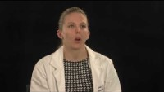
Something more going on…

Slide 28
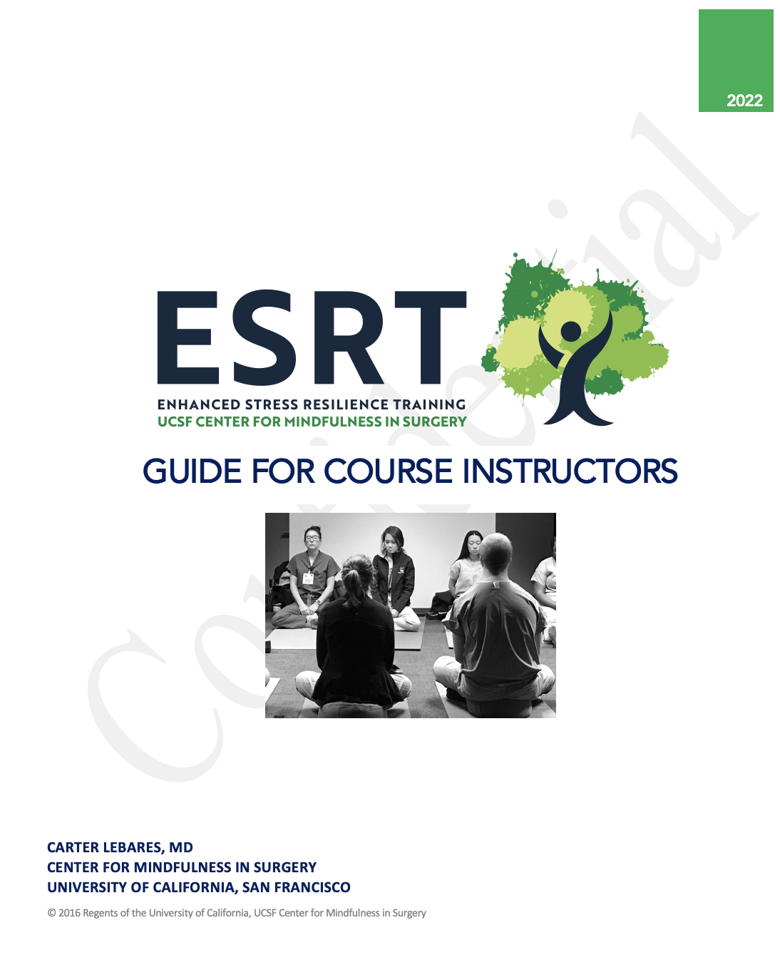
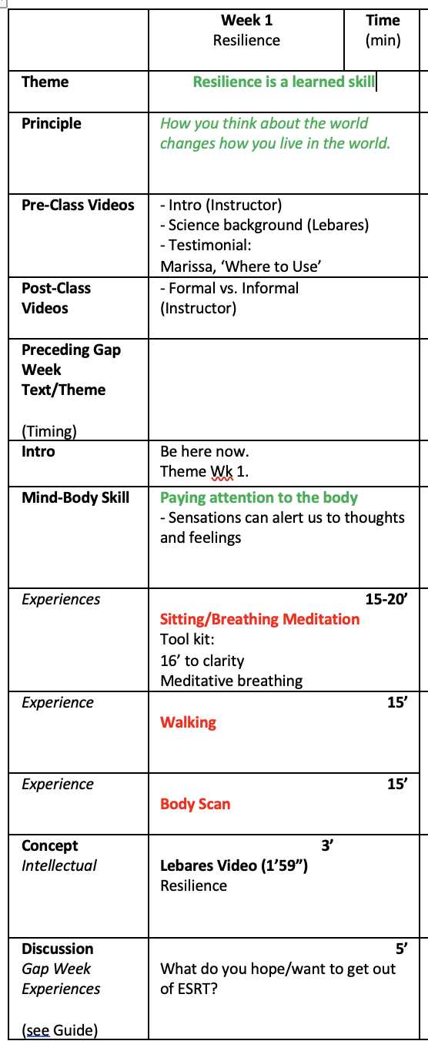
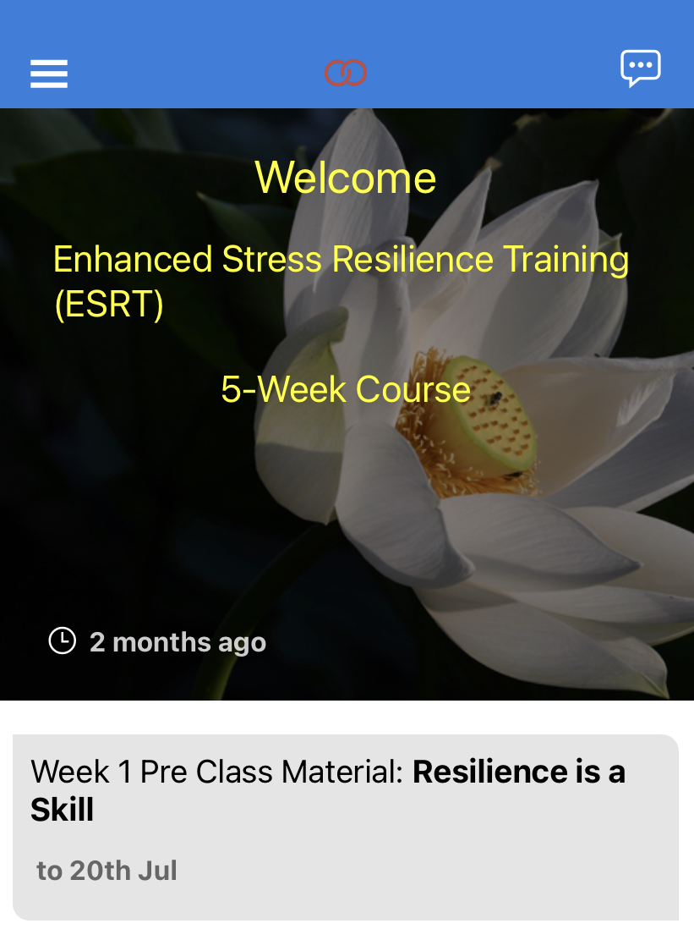
Internal Curriculum
5 weekly, 1-hour classes
Graded daily practice
Booster sessions
Course Manual
      Conceptual framework
  Applied skills
Bespoke app

Slide 29
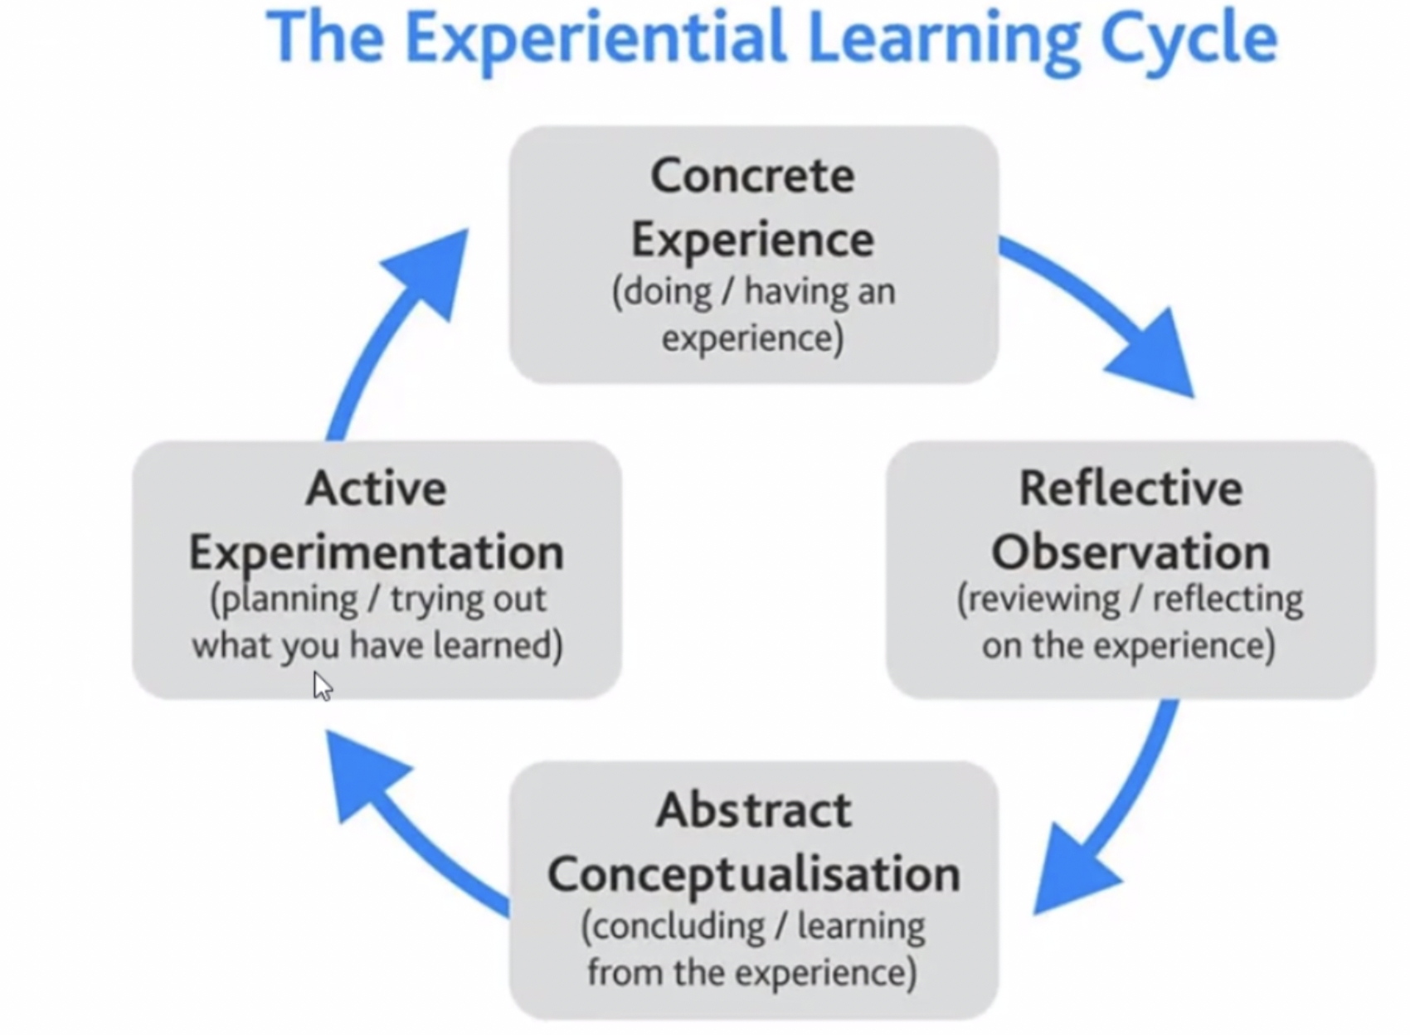
Kolb’s Experiential Learning Cycle
Learning involves acquiring abstract concepts through new experiences and being able to flexibly apply them across a range of situations.
Kolb, 1984

Slide 30
How Do Surgeons Practice Mindfulness?
Appreciations and gratitude
Thought re-framing
Daily meditation
Transition
meditations
Focus on what we love
Demoralization
Impatience
Frustration
Intolerance
Anxiety
Negativity bias
Leaving work at work
Increased productivity
Job satisfaction
New approaches
to old problems
Less reactive
Richer time off

Slide 31

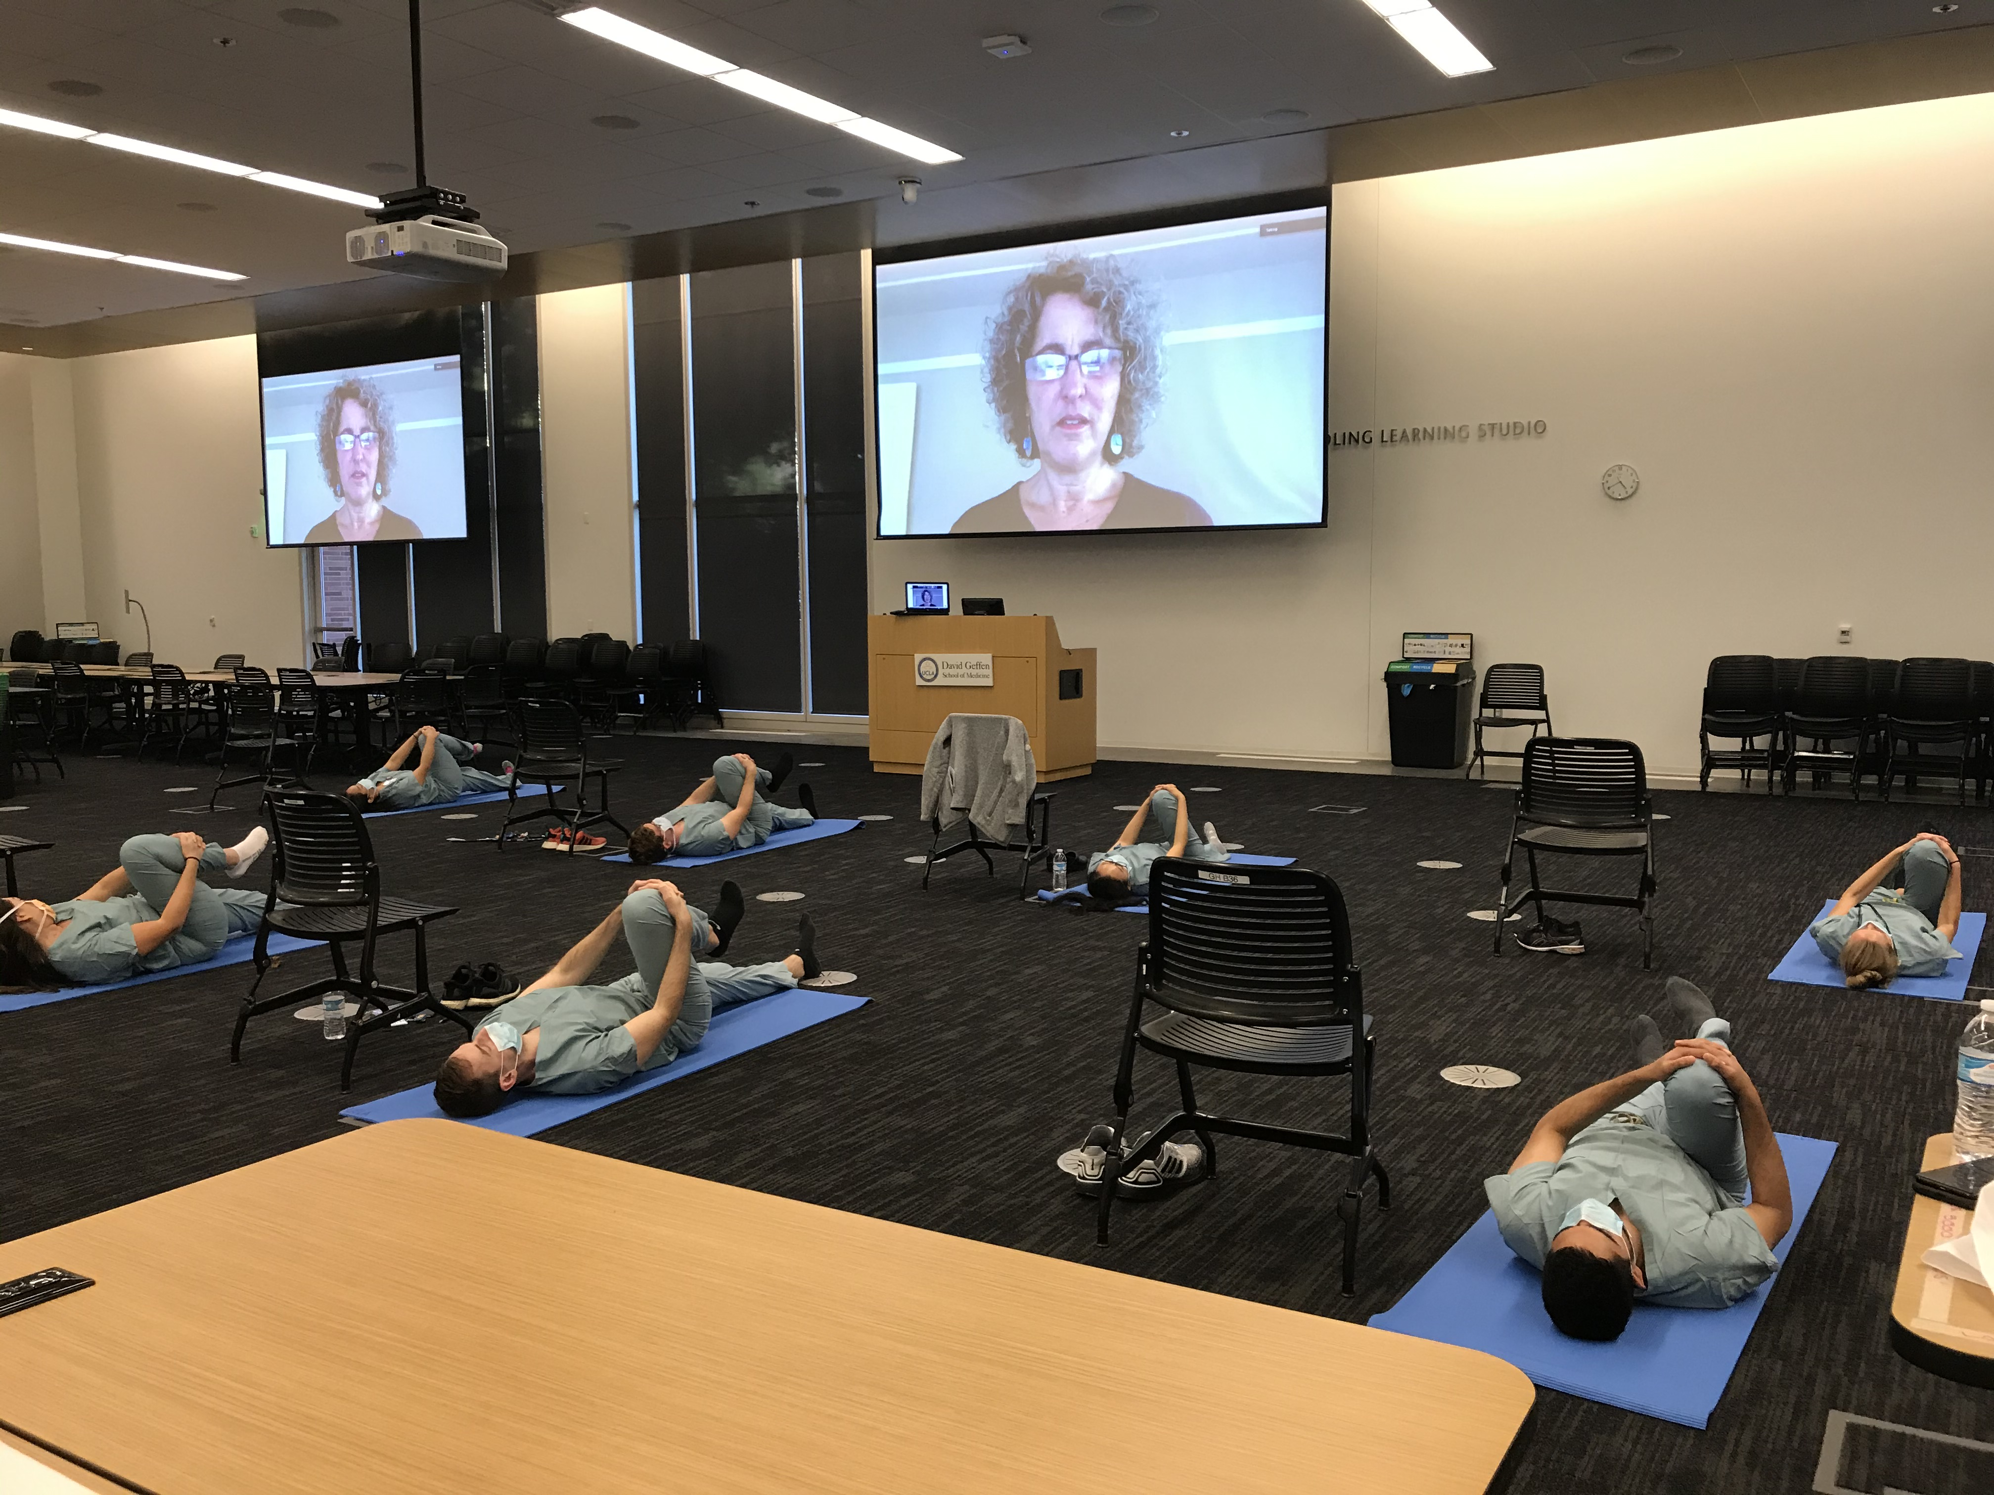
COVID & Remote ESRT
Notes:
This prompted us to adapt yet again and develop a remote/live-streamed version of ESRT which was delivered across four time zones in April 2020, to academic, community and military surgeons, and is now allowing us to continue to deliver this skill set, even with social distancing.

Slide 32
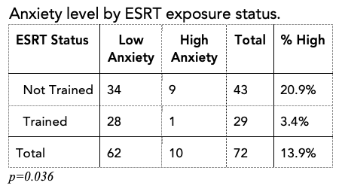
Real-life Application
Assessment of Anxiety at the start of COVID-19 (April 2020)
72 Respondents (73%)
  ESRT: n = 29 (40%)
  Non-ESRT: n = 43 (60%)
  High anxiety: GAD-7 >= 10
p = 0.036
Independent of PGY level, gender, age, number of hours worked in previous month, +/- children or partner, high exposure risk setting
Greenberg, Acad Med, 2021
Notes:
More recently, Evidence that ESRT training has value in real-world settings emerged during the onset of COVID-19, when we assayed anxiety among our residents at the height of the first surge.
We found that those residents not exposed to ESRT had a 6-fold higher odds of clinically-relevant anxiety independent of training level, gender, hospital site, hours worked, or shifts in high-exposure settings.

Slide 33



















MADIGAN ARMY MEDICAL CENTER
Notes:
So far, staying the course has been

Slide 34
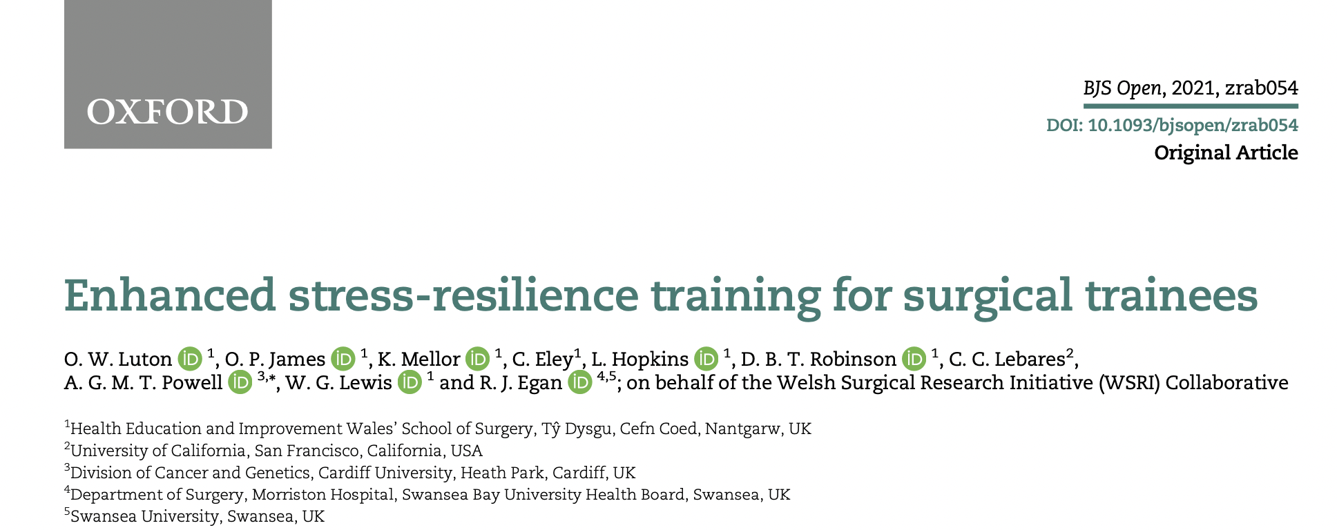


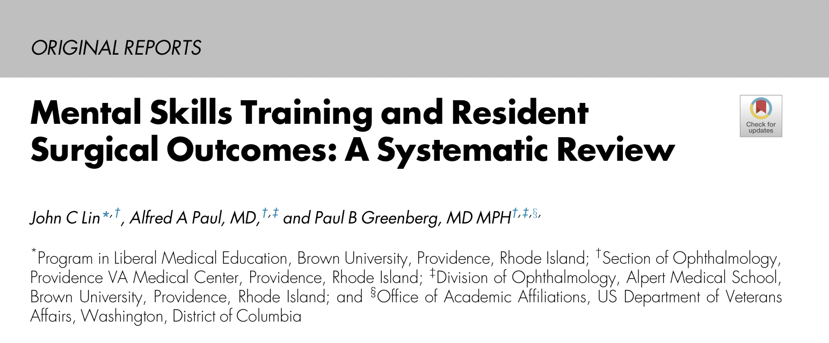
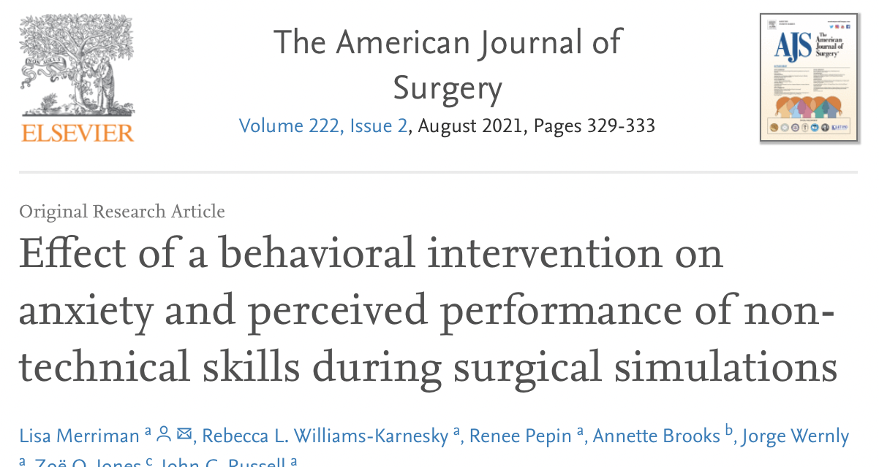
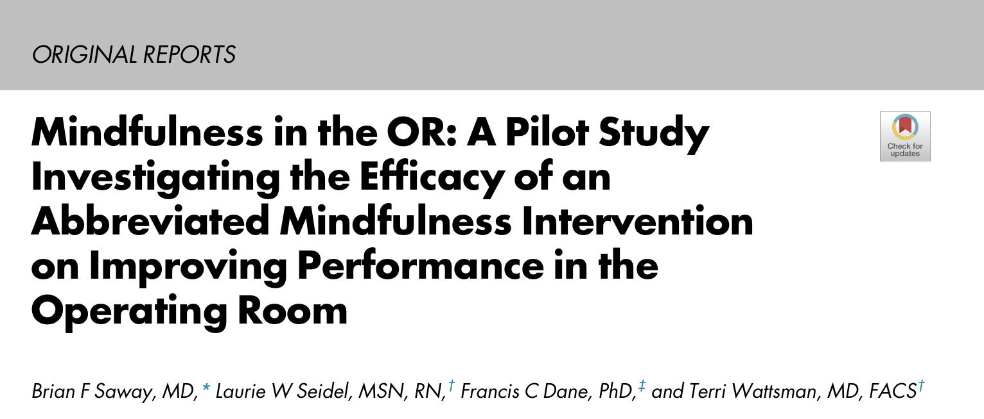
Impacts on Systems
Notes:
Similarly, other emerging literature specifically exploring the effects of MFT in surgery, is building the case that benefits extend to myriad aspects of our work and lives: this includes individual technical and non-technical performance, team performance in the OR, humanism towards our patients, and performance anxiety.

Slide 35
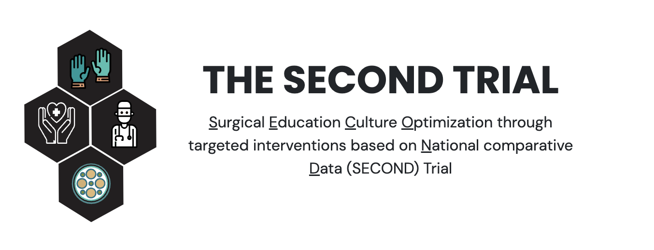
Impacts on Culture
Emotional Intelligence competencies
“[When] implemented through program-level interventions such as ESRT…:
psychological safety that fostered growth mindsets (e.g., knowing when to ask for help, seeing mistakes as opportunities to learn, positive thinking) and improved communication,
a cohesive community founded on vulnerability and experiences shared using a common language (e.g., open discussions about how to navigate stressors), and
public opportunities for expanded learning (e.g., M&M as an opportunity for growth rather than blame)
….. seen as a competitive advantage for recruiting new residents. “

Slide 36
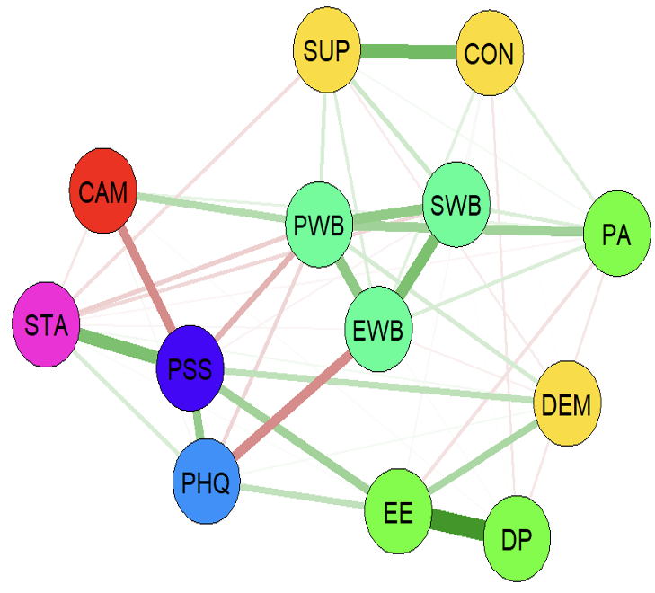
Concerning Associations:
Personal accomplishment and attrition
Anxiety and Suicidal Ideation
Emotional exhaustion and clinical performance
Depersonalization and pt experience
Workplace Support & Control
Mindful Tendencies
FLOURISHING subdomains
Personal
Accomplishment
Mediation Pathways:
MF influence mediated through PWB and Stress
Anxiety
New Questions:
Do we need different measures of workplace factors?
Is Demand the most relevant factor in our environment?
What elements of Demand are mutable?
How might we directly target other elements?
Workplace Demand
Stress
Depression
Hu, NEJM, 2019
Emotional Exhaustion & Depersonalization
Khorfan, Ann Surg, 2021

Slide 37
Innovations Take Time

Slide 38
Thank you
https://CarterLebares.org
https://MindfulSurgeon.ucsf.edu

